Slide 1
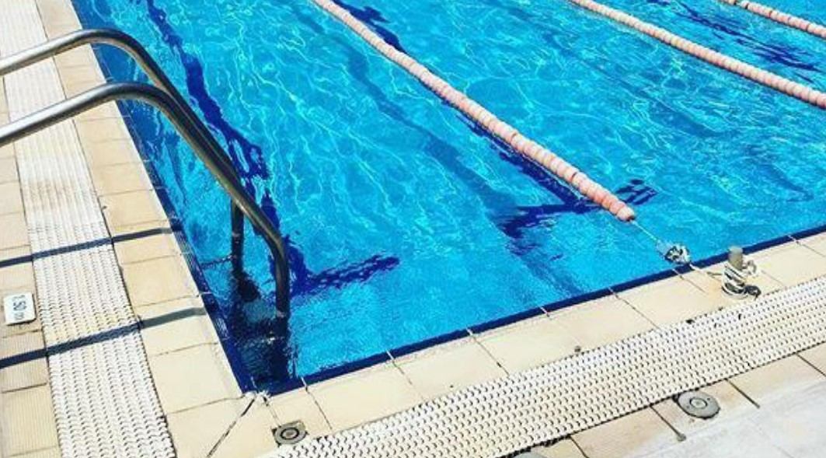
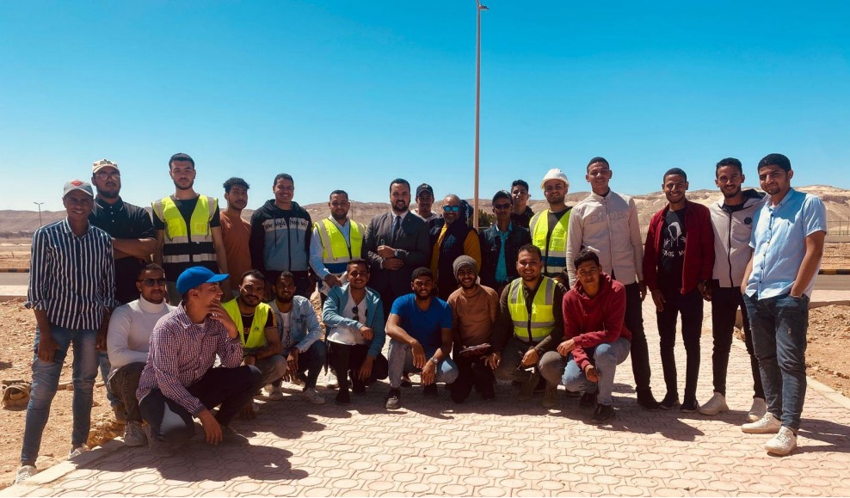
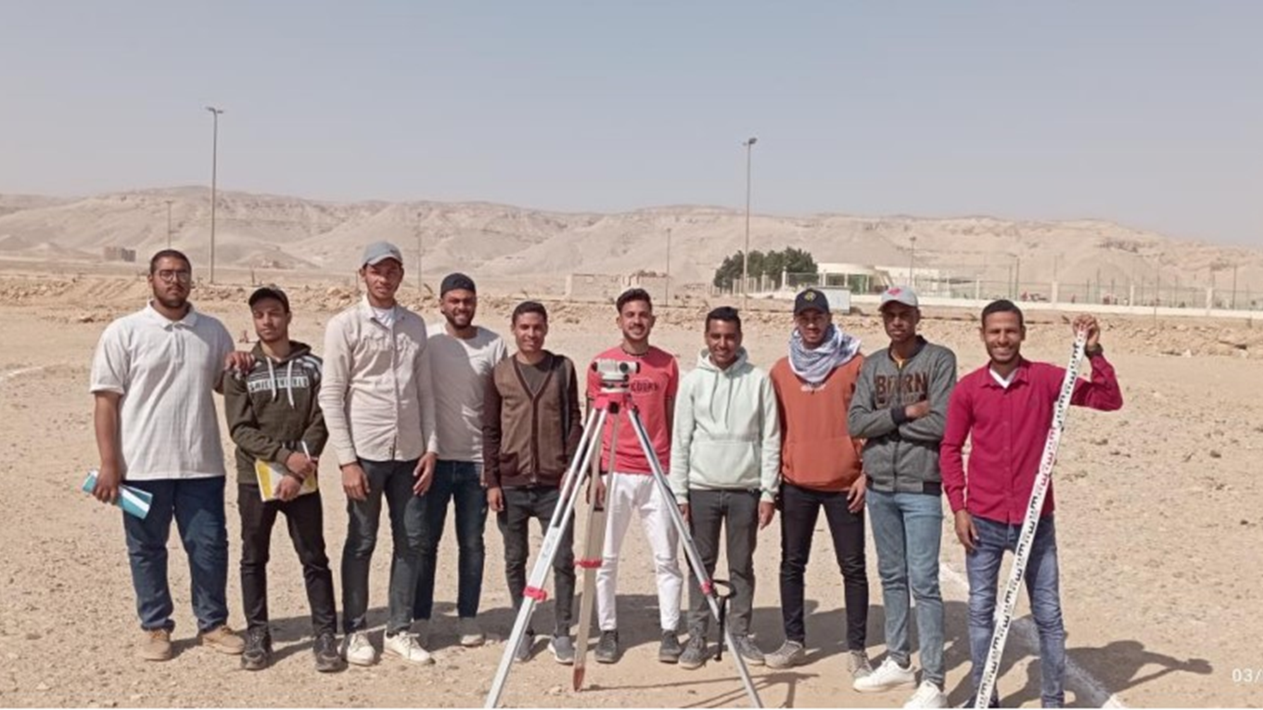
SURVEY and PROJECT
Contoso
mey21, 2023

Slide 2
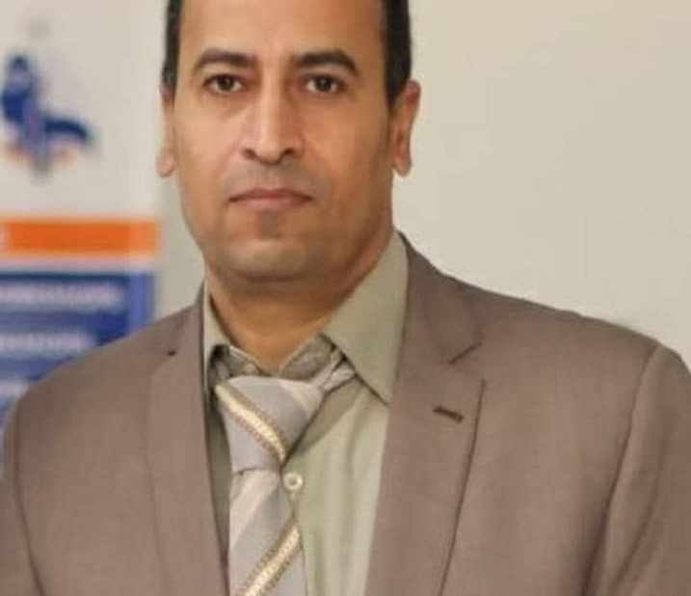
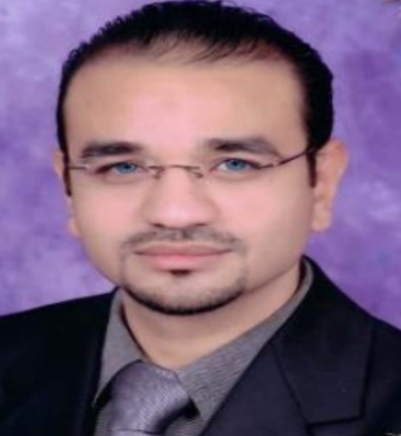
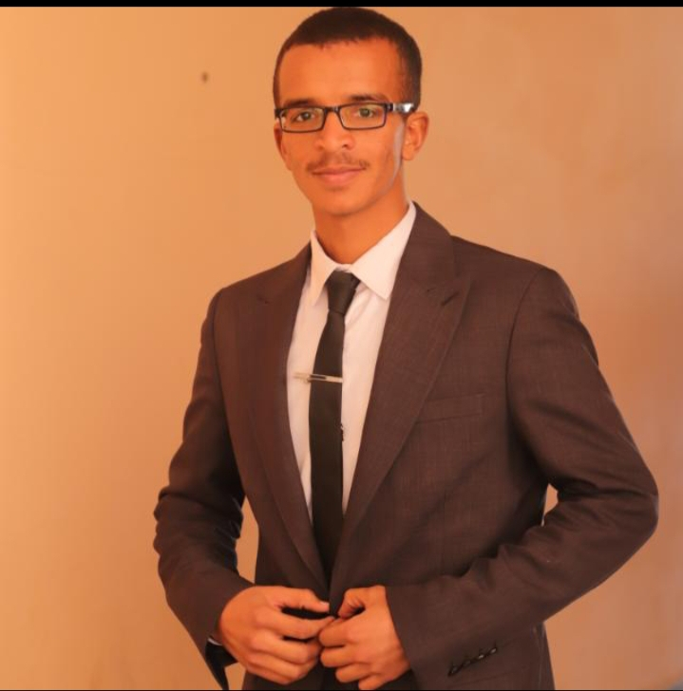
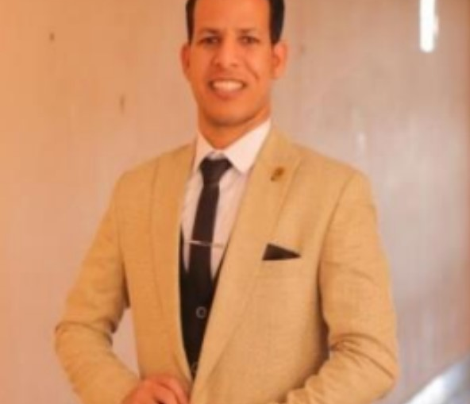
Welcome to project Survey :-
Project Manager
project moderator
Assistant
Assistant
Dr/Mohamed Mahmoud Ali
Dr/Mahmoud Abdel Rady
Dr/Basim Khaled Mohamed
Dr/Omar Mohamed Soliman

Slide 3

Introduction
Project Manager:-
Dr/Mohamed Mahmoud Ali
Professor, Faculty of Engineering, Qena University, Department of Mining and Energy
Member of the discussion committee:-Dr/Mahmoud Abdel Rady
Doctor in the Department of Surveying and Maps, Faculty of Arts, Suhag University.
Assistant:-
Dr/Basim Khaled Mohamed
Teaching Assistant, Department of Surveying and Maps, Faculty of Arts, Suhag University.

Slide 4
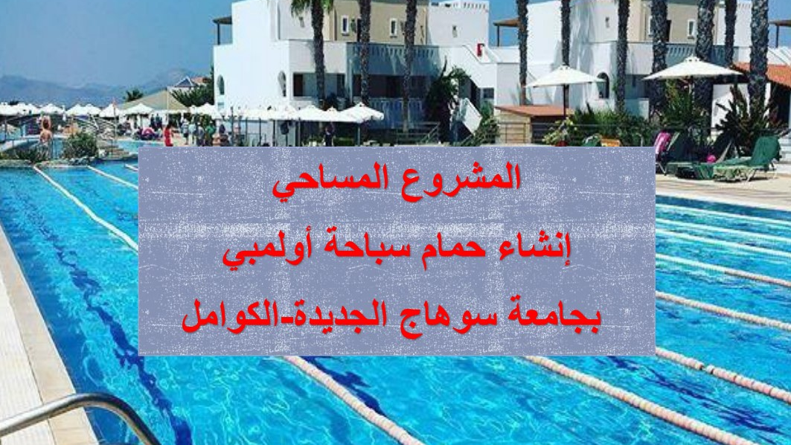
Results from last year
Let’s dive in

Slide 5
Contents:-
OLYMPIC SWIMMING POOL.
WORK TEAM.
DEBATERS.

Slide 6
خارطة العمل
بداية العمل في المشروع
الموقع
الاجهزة
الحل
المشكلات
الأدوات المسخدمة
المصادر والمراجع
المشروع النهائي

Slide 7
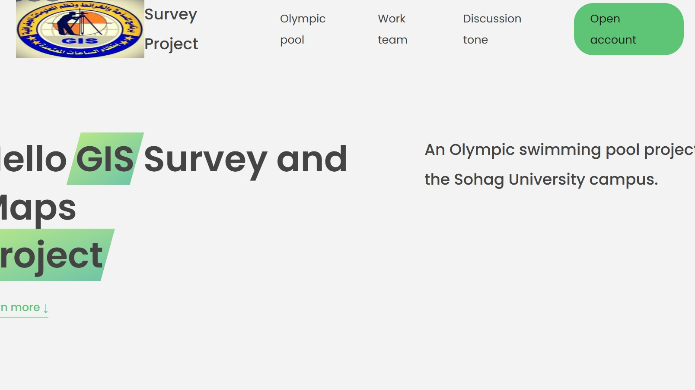
Web pa

Slide 8
OLYMPIC SWIMMING POOL:-
The project Location
Practical
Output or final form
The project is located on the campus of the new Suhag University in El Kamel City.
Sketch of the project.
and depth of the project.
Locate the working project
Install points.
The use of devices in the surveying process.
Form of excavation and filling using Global Mapper.
Swimming pool coordinates in Auto cad 2019, Auto cad civil 3d .
The final form of the legislator.
ARC Map, Surfer.

Slide 9
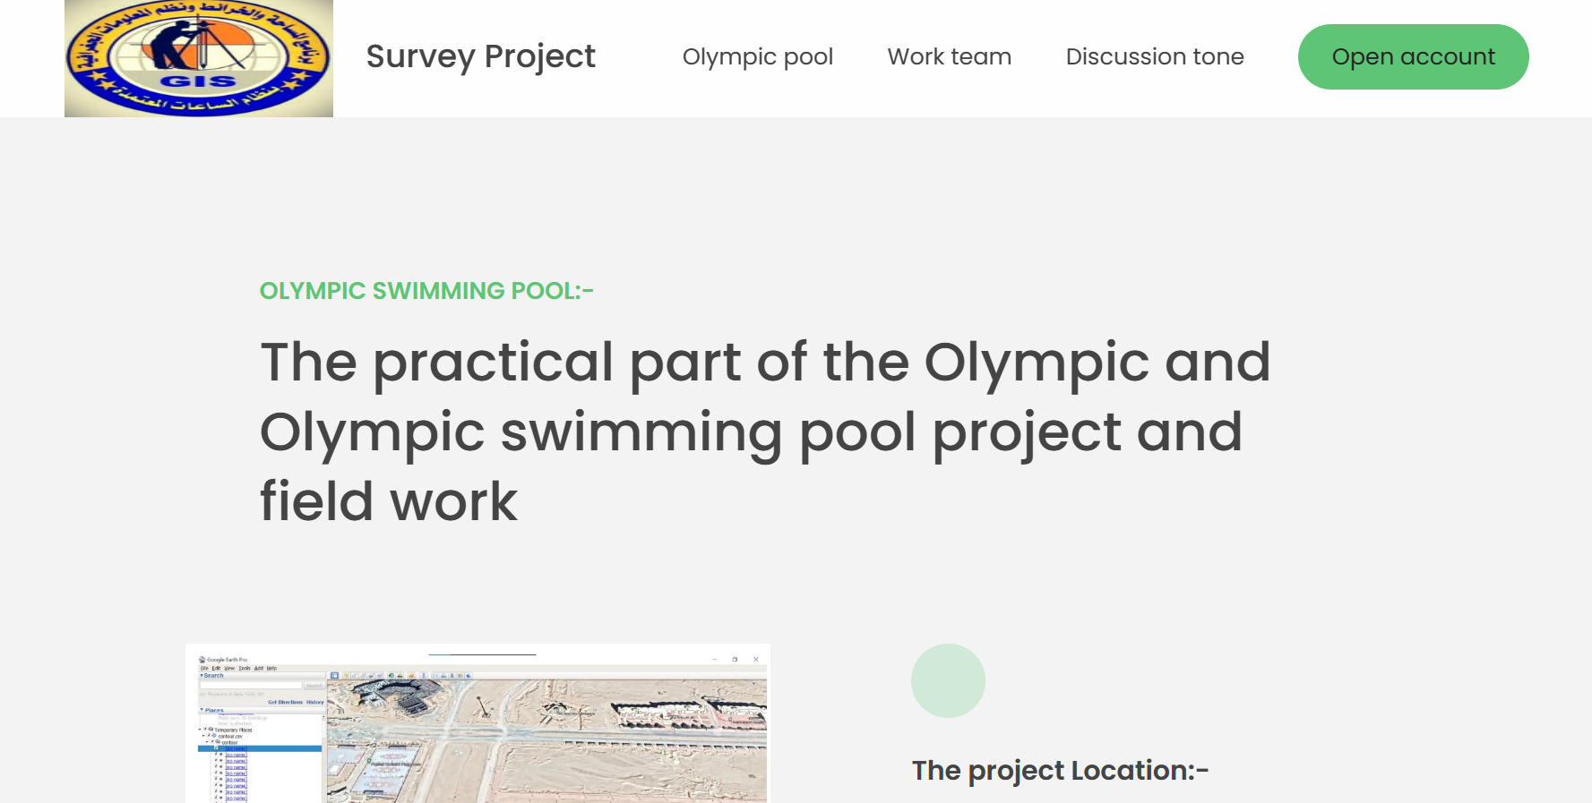

Slide 10
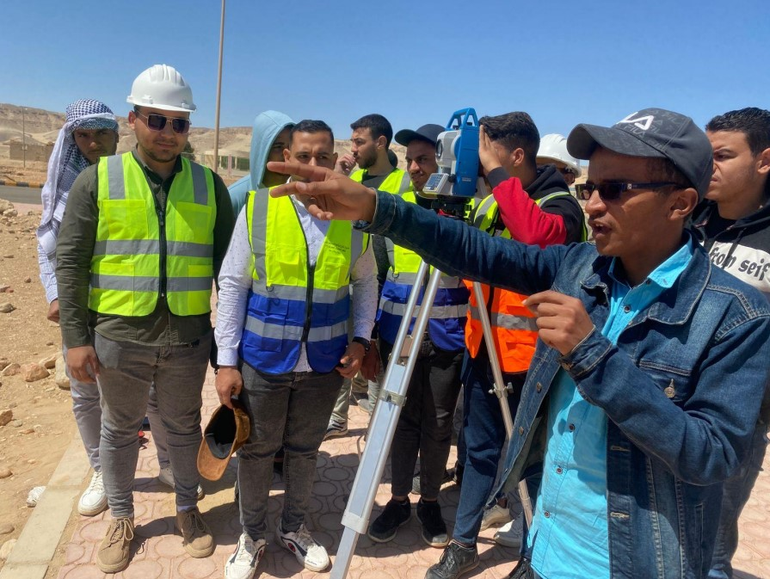
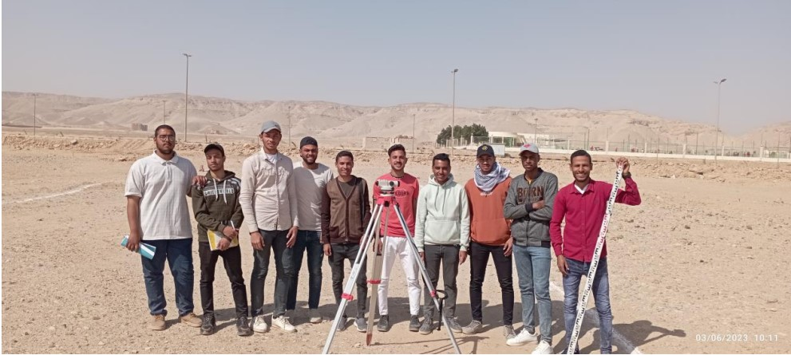
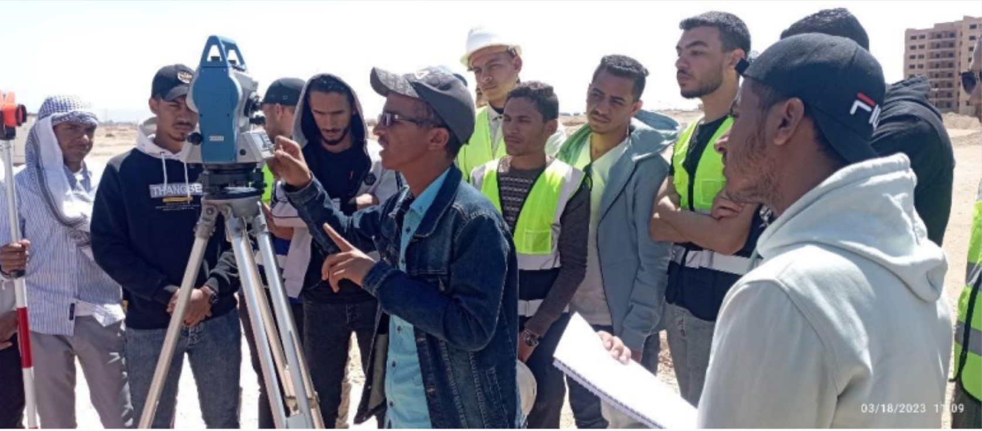
WORK TEAM

Slide 11
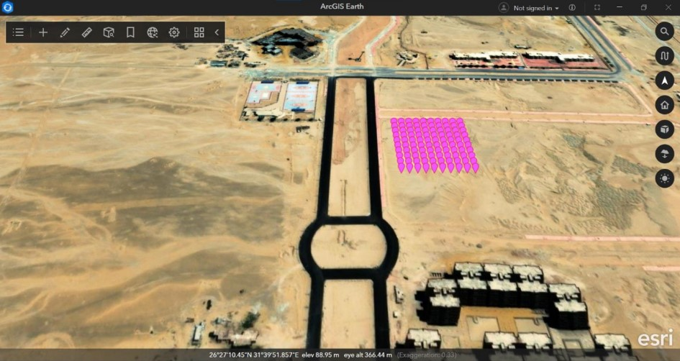
DEBATERS
Project Manager
Member of the discussion committee
Assistant
Dr/Mohamed Mahmoud Ali
Professor, Faculty of Engineering, Qena University, Department of Mining and Energy
Dr/Mahmoud Abdel Rady
Doctor in the Department of Surveying and Maps, Faculty of Arts, Suhag University
Dr/Basim Khaled Mohamed
Teaching Assistant, Department of Surveying and Maps, Faculty of Arts, Suhag University

Slide 12






Summary
We’re delivering for our customers
Last year we supported thousands of customers and sold 60,000 units
Our business is good
Profits are up in the last quarter by 3%
Our customers keep coming back
We increased customer retention by 4%
We’re getting our work done
We finished the consolidation project
Our team is growing
We welcomed 3 new team members last quarter
We’re leaders
We are top leaders in the industry across the board

Slide 13
Conclusion
Thanks to your commitment and strong work ethic, we know next year will be even better than the last.
We look forward to working together.
Mahmoud Ahmed Khalaf
m01159755345@gmail.com

